Slide 1
Centre for Computational Science, ADVANCED RESEARCH COMPUTING CENTRE,
University College London & INSTITUTE FOR INFORMATICS, UNIVERSITY OF AMSTERDAM
Uncertainty Quantification for
High-Dimensional Parameter Spaces
Physics-based versus AI models
Peter Coveney
Centre for Computational Science &
Advanced Research Computing Centre, UCL (UK)
Institute of Informatics, UVA (NL)
Workshop on Uncertainty Quantification
for High-Dimensional Problems
CWI, Amsterdam, 11 November, 2024

Slide 2














Acknowledgements
UCL
Shunzhou Wan
Maxime Vassaux
Yiming Yang
Serge Guillas
CWI
Wouter Edeling
Brunel University London
Derek Groen
… and many more
ucl.ac.uk/mesoscale-modelling-consortium/
Notes:
In addition to the credits of the movie, I should also acknowledge lots of support – thanks to everyone here and there are a lot more
VISION THANG
When it comes to our vision, just as a weather forecast relies on a mathematical model of the Earth’s atmosphere, running on a supercomputer using data from meteorological stations, satellites and other instruments, one day mathematical models of a patient will be constantly updated with information from the body to produce healthcasts.
Your digital twin would be your lifelong, personalised clone that ages just like you, as it is constantly updated with each measurement, scan or medical examination that you have at the doctor’s, along with behavioural, environmental, genetic and a plethora of other data.
One day in the next two decades, it will be possible to conduct a trial on a digital copy of you rather than infer your possible fate on the basis of previous trials on other people who bear a resemblance to you.
Why stop at one virtual twin? Within a supercomputer, many virtual versions of you can simultaneously explore your many possible futures, depending on your diet, medication, lifestyle and environment. With enough computational power, life can be sped up to chart the long-term effects of a novel drug on aging, quality of life and even time of death.
An army of virtual twins could be born, age and then die on a supercomputer within a few hours. We could use virtual humans to show how to prevent illness as well. A virtual copy of you can be used to simulate the accumulated effects of small changes in diet, exercise and lifestyle over the decades. Our hope is that Medicine will shift to being truly predictive to using digital twins

Slide 3


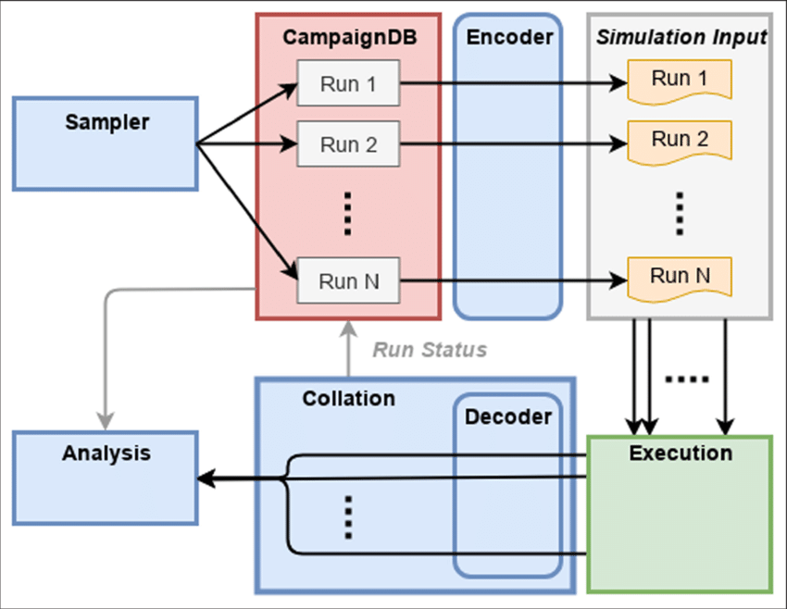
Our Toolkits for VVUQ
Provides certification for VVUQ: makes it simple to quantify uncertainties.
Open-source EasyVVUQ application, contained within the VECMA and SEAVEA toolkits
Contains many standard methods & lots of others:
Quasi Monte Carlo
Polynomial chaos
Stochastic Colocation
Multi-objective Gaussian processes
Sampling schemes

Slide 4

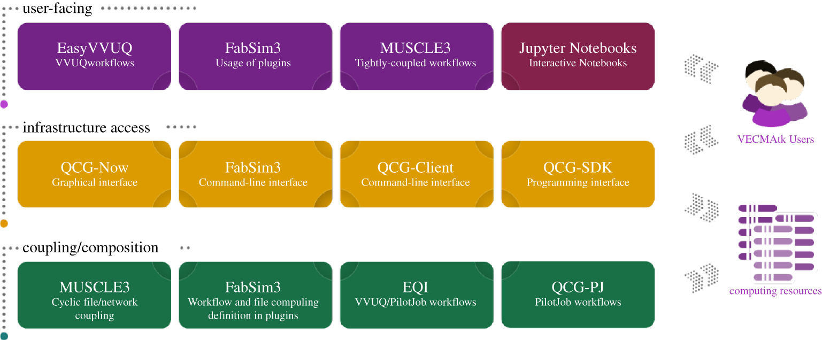
VECMA toolkit (VECMAtk)
A flexible software environment for single- and multi-scale simulations that introduces directly applicable and reusable procedures for verification, validation (V&V), sensitivity analysis (SA) and uncertainty quantification (UQ).

Slide 5














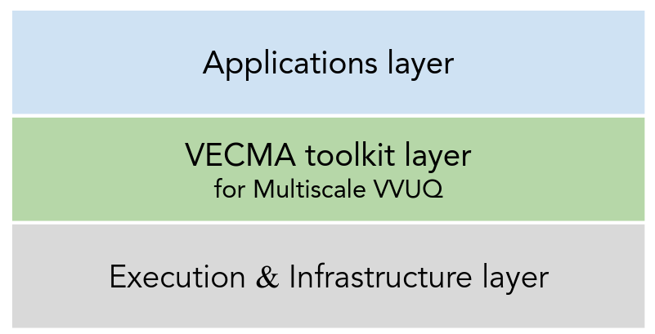
The SEAVEA Toolkit
https://www.seavea-project.org/
SEAVEA
Software Environment for Actionable & VVUQ-enabled Exascale Applications
3-year EPSRC project with 12 partners
Objectives:
Enable Verification, Validation and Uncertainty Quantification (VVUQ) for large multiscale & multiphysics applications.
Targets petascale HPCs and exascale supercomputers.
Apply to diverse domains: fusion, materials science, climate modelling, human migration and bio-medicine
Multiple methods and lots of features: QMC, PCE, SC, multi-objective GP, DAS, gKDR etc.
Architecture:
SEAVEA toolkit layer
for Multiscale VVUQ

Slide 6
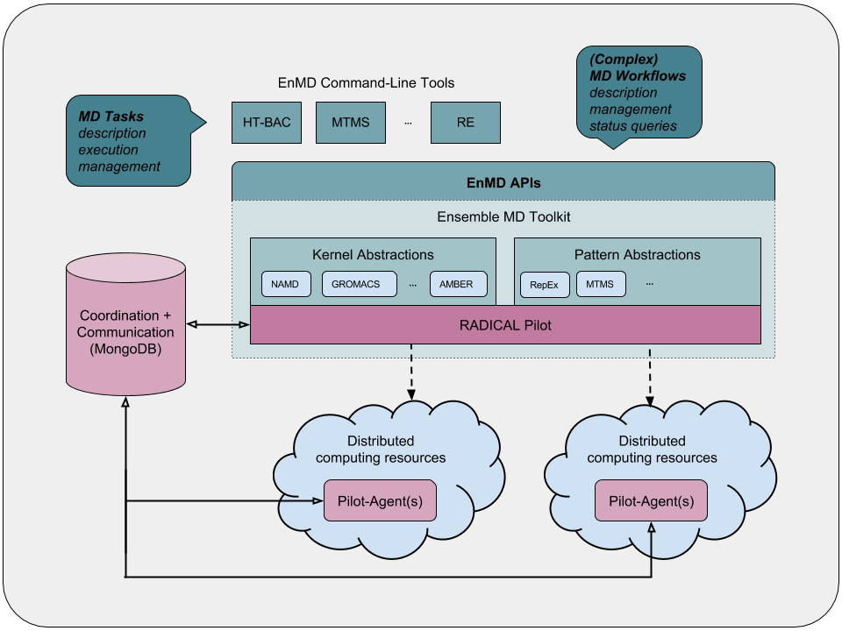
Implementation of ensemble-based applications
Ensemble Toolkit, one of the RADICAL-Cybertools components, provides a simple way to develop applications comprised of multiple tasks which conform to flexible sets of patterns.
A. Alsaadi, D.H. Ahn, Y. Babuji, K. Chard, J. Corbett, M. Hategan, S. Herbein, S. Jha, D. Laney, A. Merzky, T. Munson, M. Salim, M. Titov, M. Turilli, T.D. Uram, and J.M. Wozniak. 2021. ExaWorks: Workflows for Exascale. In 2021 IEEE Workshop on Workflows in Support of Large-Scale Science (WORKS). 50–57. https://doi.org/10.1109/WORKS54523.2021.00012

Slide 7
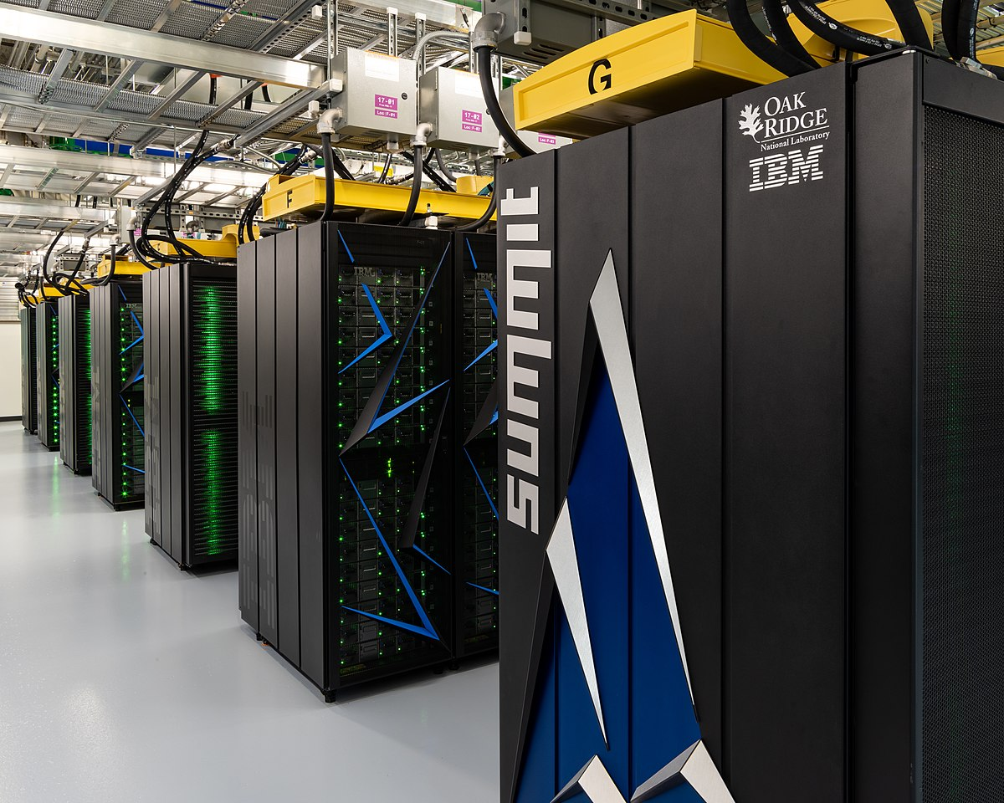



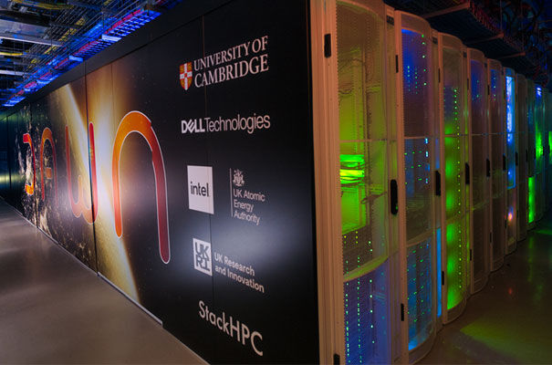
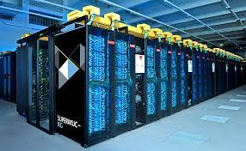

High-dimensional UQ studies require big supercomputers
New emphasis on ‘VVUQ’ ==> trusting predictions, making them actionable
Increasing opportunities as high performance computing moves from petascale to exascale
Summit
Blue Waters
Titan
Frontier, first benchmarked exascale machine
Aurora
Dawn
SuperMUC-NG 2
Notes:
Our ability to put the spark of life into mathematical equations has also been transformed in recent years by the rise of high-performance computing— supercomputers.
There is another reason why digital twins are swimming into view
Today, we are moving from the petaflop era to that of exascale machines, where exa- denotes three orders of magnitude better capabilities compared to their petascale predecessors.
These computers will be capable of at least one million million flops, that is, a one followed by 18 zeros. To match what an exascale machine can do in just one second, you would have to perform one calculation every second for 31,688,765,000 years.
This next generation of exaflop behemoths is winking into life: in Japan, Fugaku; in China, Sunway Oceanlite, Tianhe-3 and Shuguang; in the US, Aurora, Frontier and El Capitan, and in Europe, Jupiter.
Never satisfied, scientists and computer engineers are already thinking about machines that are a thousand or a million times more powerful again, in zetta and yottascale machines

Slide 8
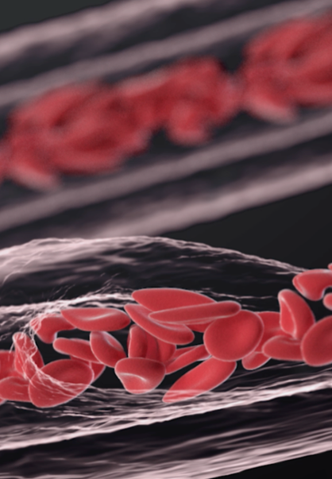
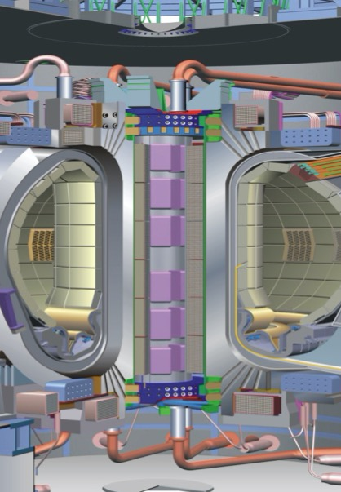
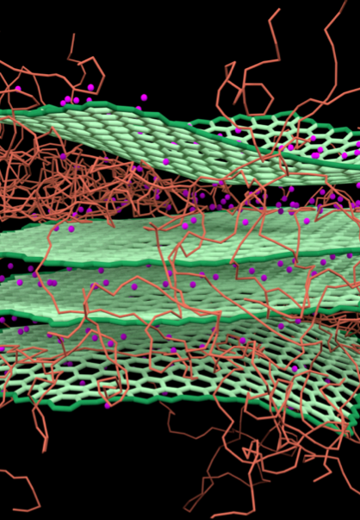
Real-world applications are frequently HPC class
Multiscale and multiphysics: theory, modelling and simulation in combination with ML/AI
High performance and distributed systems
Validation, verification and uncertainty quantification
Biomedicine
The computational biomedicine community is adopting VVUQ procedures defined by the FDA inter alia.
Fusion Energy
Developing models to study nuclear fusion that potentially provide a carbon free solution to the provision of base load electricity, without geopolitical complications.
Advanced Materials
For computational modelling and simulation in multiscale materials research and discovery

Slide 9
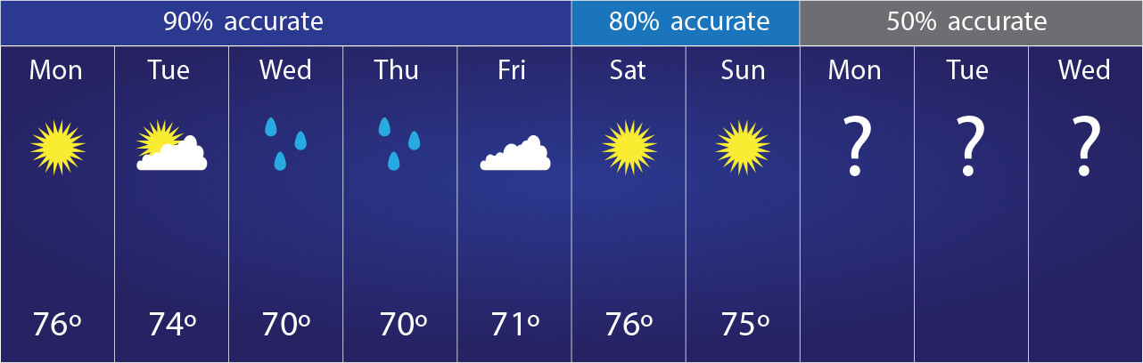
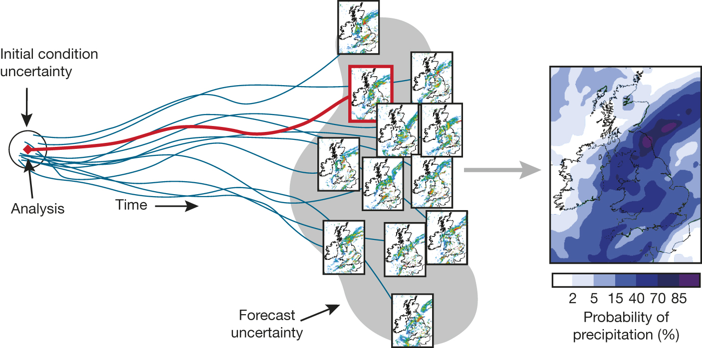
Uncertainty quantification in climate and weather prediction
Uncertainty exists in the same model
Deterministic
forecast
Notes:
We have to be aware of the butterfly effect, discovered in the early sixties when Edward Lorenz at MIT was trying to simulate the Earth’s atmosphere with a set of three coupled ordinary differential equations—simplified NavierStokes equations—that describe convection, the fluid movement you can see a cup of hot coffee.
But when he tried to repeat his initial simulation, he got different results. On closer inspection, Lorenz found that the differences resulted from a tiny rounding error in the numbers fed into his computer. You might expect that a small error would lead to a small difference. But wildly diverging results span out of a change in even the last decimal place in his numbers.
Chaos rules the weather too and, to deal with it, ensemble methods are employed where slightly different starting conditions and values of uncertain parameters are fed into weather prediction models to cover the range of possible expected weather events—for instance, where a hurricane might strike. One run of a code that is exquisitely sensitive to its initial conditions will produce different answers from the next. Importantly, however, these ensemble calculations do generate seemingly reliable averages.

Slide 10
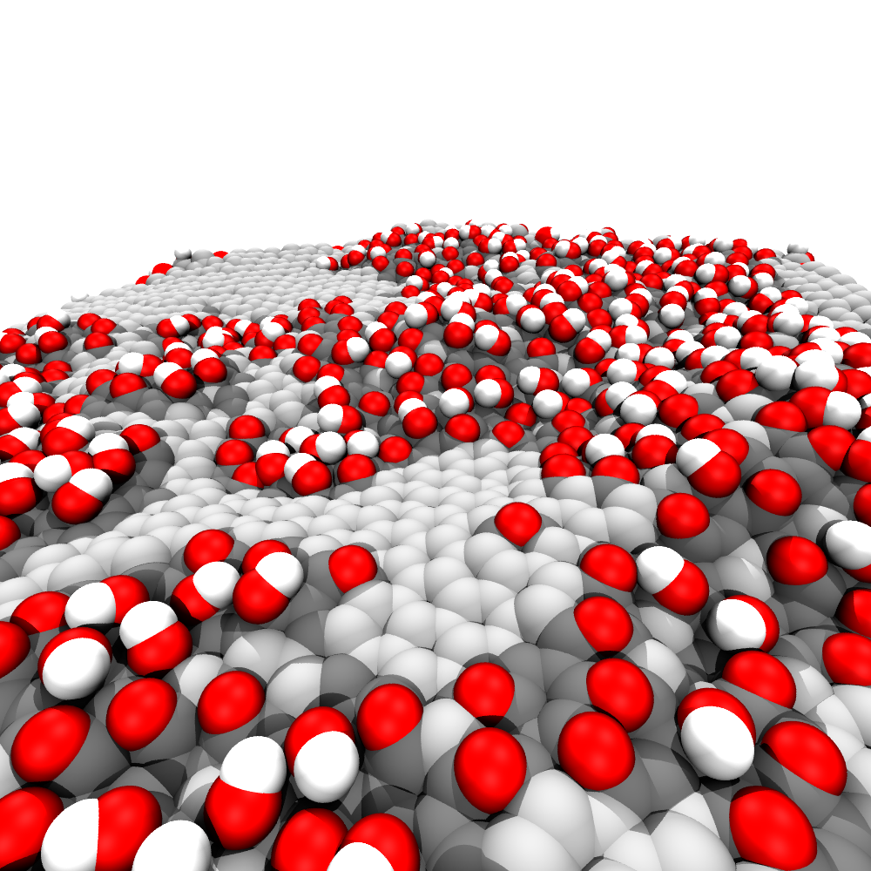
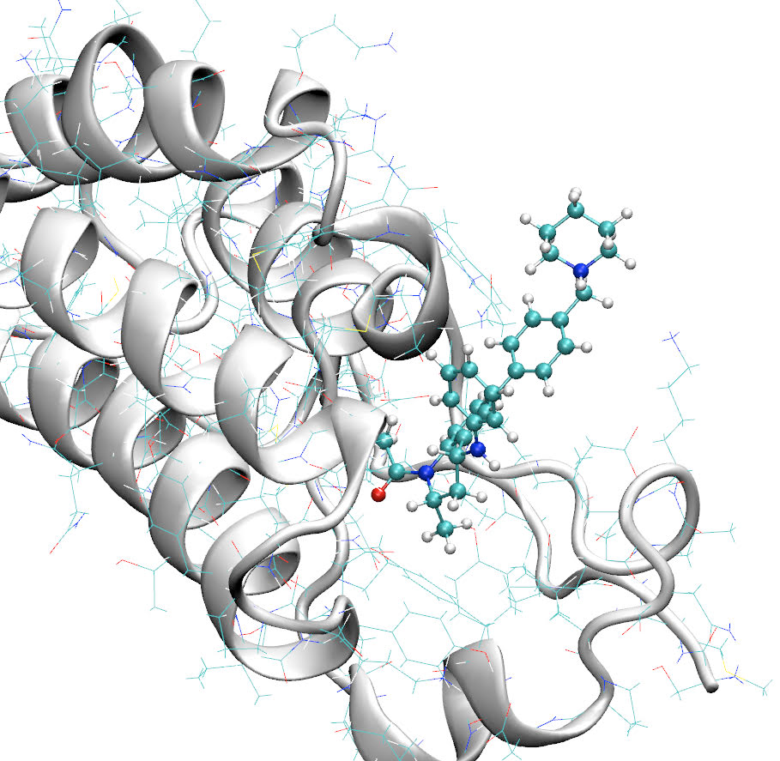
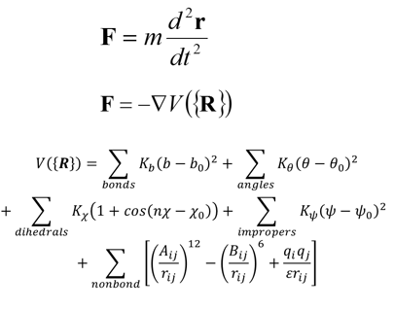
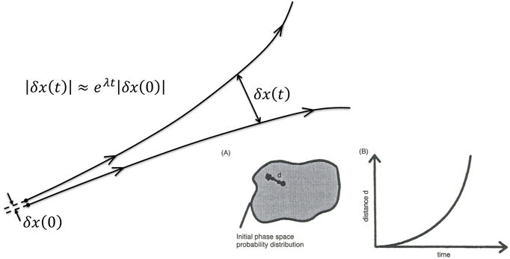
Molecular Dynamics
Newton’s equations of motion, complex force field, N-body dynamics
Programming them on a computer
Linking MD to thermodynamics: exploring macroscopic behaviour through molecular interactions.
Lyapunov instability leads to chaotic systems
small errors, large deviations
sensitive to uncertainty, need to quantify it!
Boghosian, Coveney and Wang. Adv. Theor. Simul. (2019) 2.12
Wan, et al. J. Chem. Theory Comput. (2015) 11, 7, 3346–3356
Suter et al.,. Adv. Mat. (2020) 32.36
Coveney, Wan. Phys. Chem. Chem. Phys. (2016) 18, 30236-30240
http://gsp.tamu.edu

Slide 11
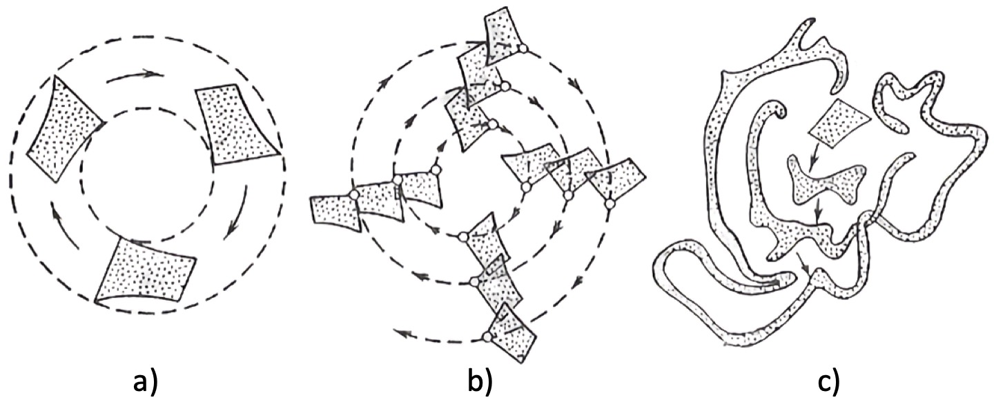
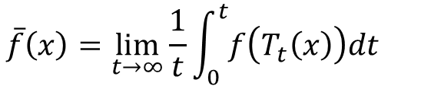
Non-ergodic, Ergodic and Mixing Systems
Birkhof’s (ergodic) theorem
To ensure that Birkhof’s (ergodic) theorem is satisfied, and thus that a time average can replace an ensemble average, an MD simulation would need to run for the order of a Poincaré recurrence time, orders of magnitude longer than the lifetime of the Universe.
http://gsp.tamu.edu

Slide 12
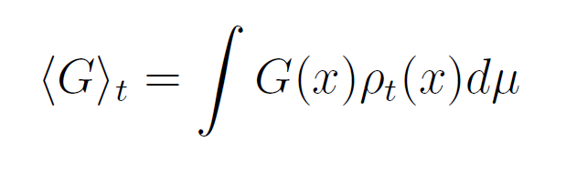
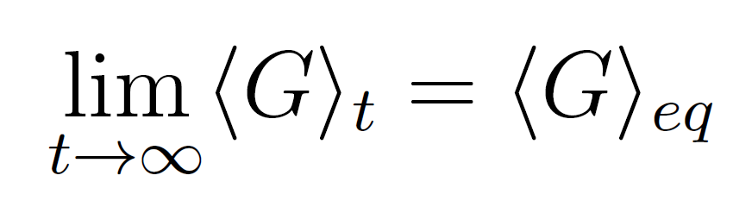
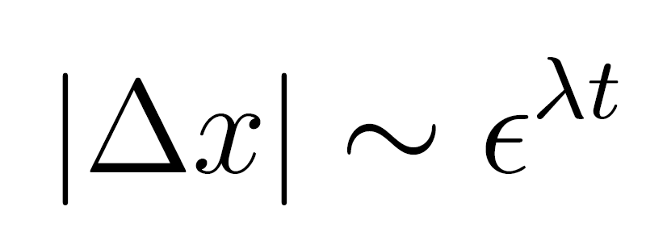
Ensemble MD: the necessity of ensembles
The expectation value of the macroscopic observable G is an ensemble average over phase space.
The ergodic theorem does not hold over accessible timescales. This would take on the order of a Poincaré recurrence ( > age of the universe)
Due to chaos, two trajectories that are arbitrarily close in phase space diverge exponentially over time.
Ensemble averaging is essential for obtaining precise results and accurately quantifying uncertainties.

Slide 13
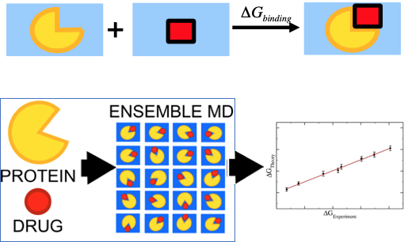
Ensemble-based end-point free energy calculation using classical molecular dynamics (MD)
ESMACS: enhanced sampling of molecular dynamics with approximation of continuum solvent
Ranking binding affinities:
Evaluate large number of promising compounds
Structurally and chemically diverse
Ranking of binding free energies
Ensemble simulation for reliable predictions
Lower computational cost

Slide 14
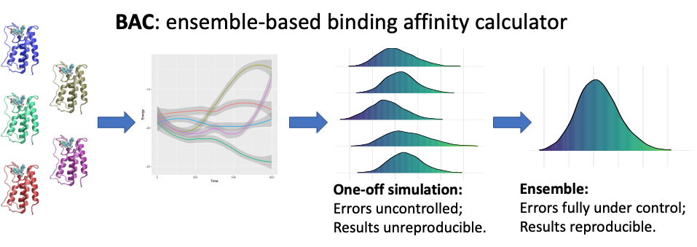
Ensemble simulations in classical molecular dynamics
Performing ensemble simulations and obtaining averages leads to more reliable results
Ensemble averaging helps to eradicate aleatory errors on stochastic simulations, e.g. in drug affinity ranking
Vassaux et al., J. Chem. Theory Comp. (2021) 17 (8), 5187–5197
P. V. Coveney and S. Wan, Phys. Chem. Chem. Phys., (2016), 18, 30236-30240

Slide 15
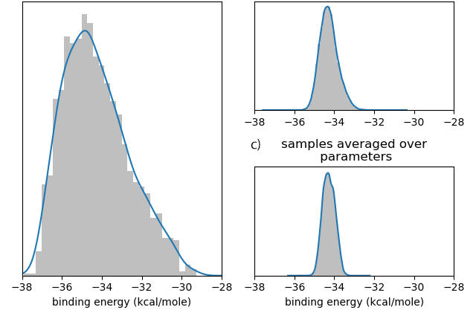
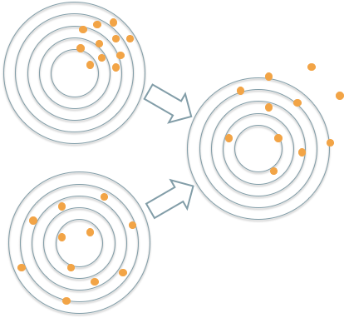
BAC: Uncertainty Quantification
distribution of predicted free energies
influence of ensemble and parametric averaging
distributions are often non-normal
Force field parameters excluded
all samples 𝝈 = 1.63 kcal/mole
averaged over replicas 𝝈 = 0.45 kcal/mole
parametric
averaged over parameters 𝝈 = 0.31 kcal/mole
aleatoric
Vassaux et al., J. Chem. Theory Comp. (2021) 17 (8), 5187–5197

Slide 16
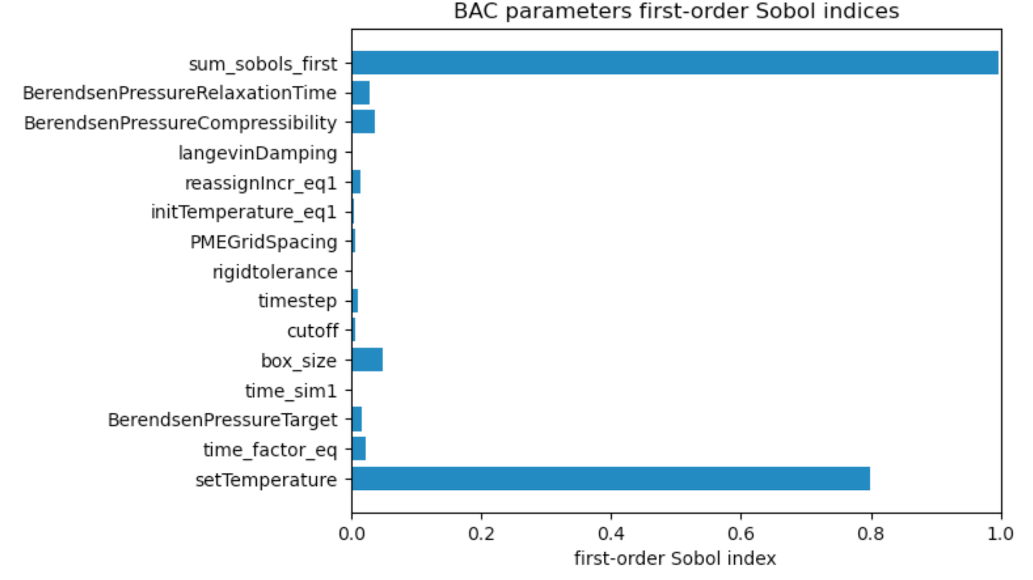
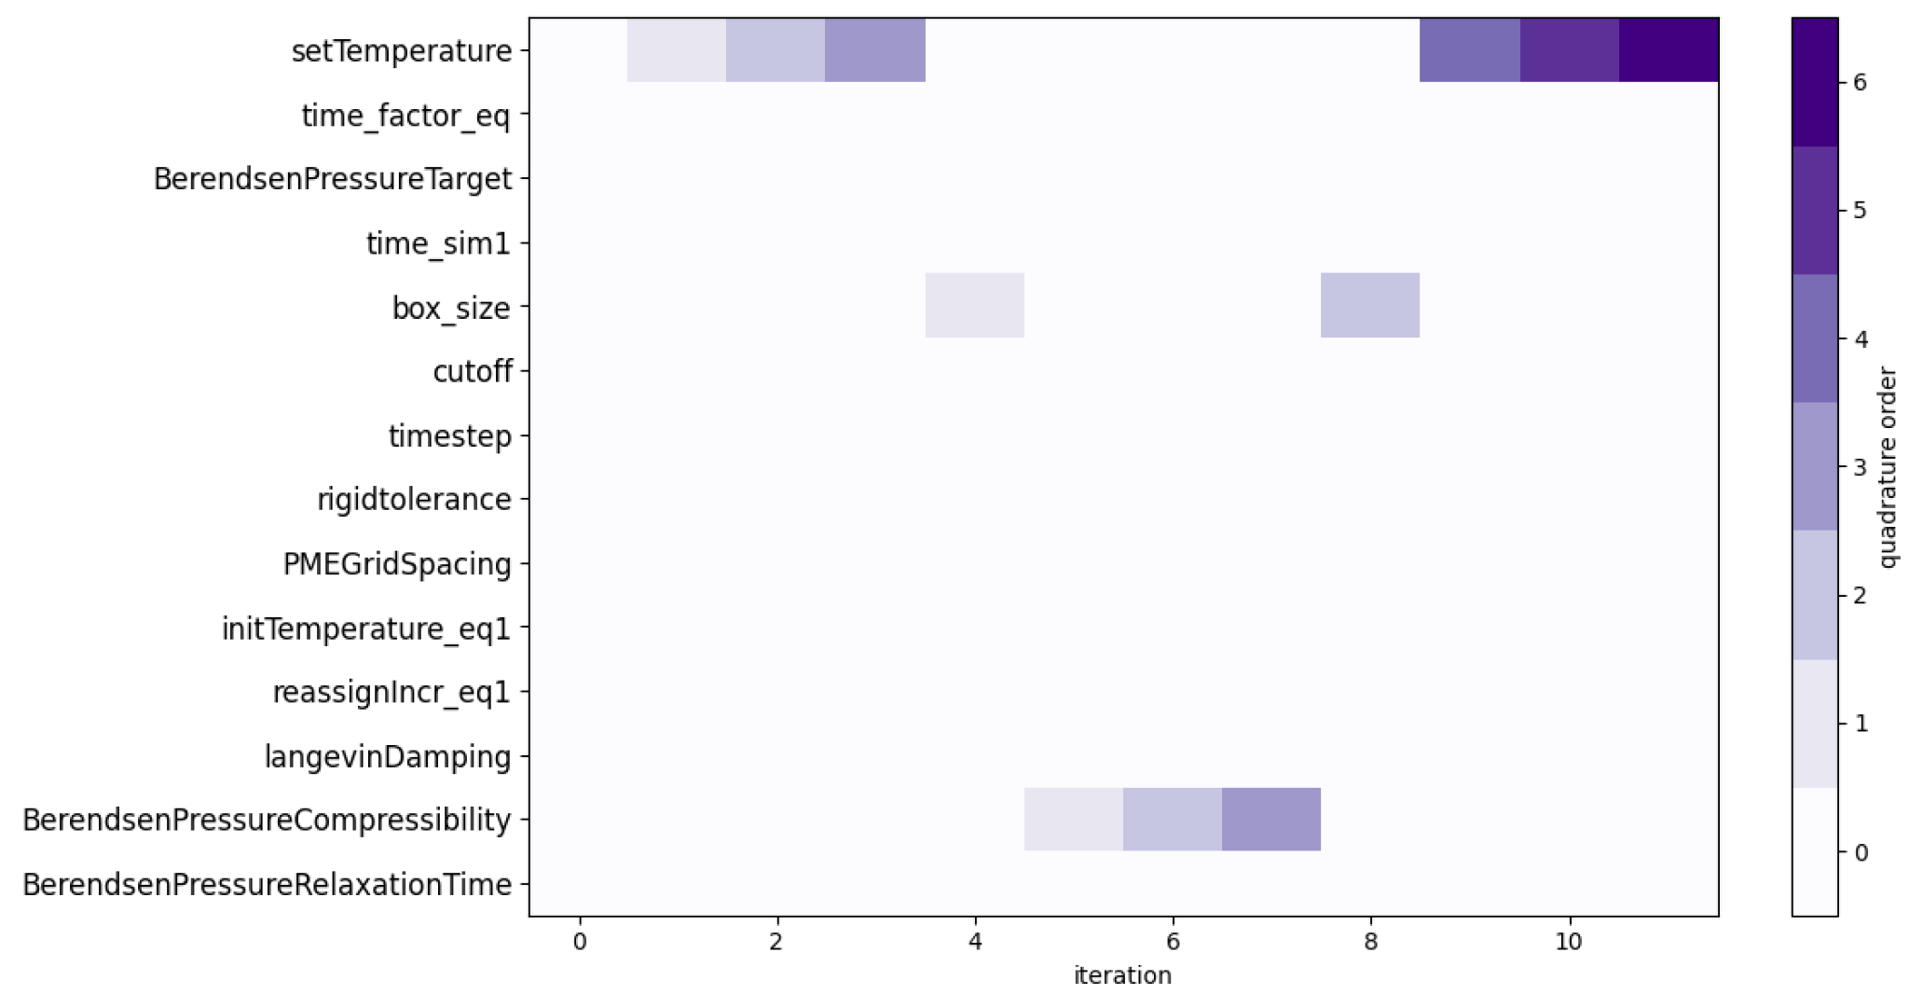
Free energy prediction: sensitivity analysis
3 most-influential parameters: temperature, box size and compressibility
re-evaluation of temperature uncertainty
Vassaux et al., J. Chem. Theory Comp. (2021) 17 (8), 5187–5197

Slide 17
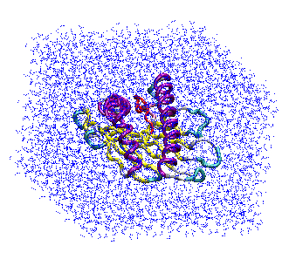
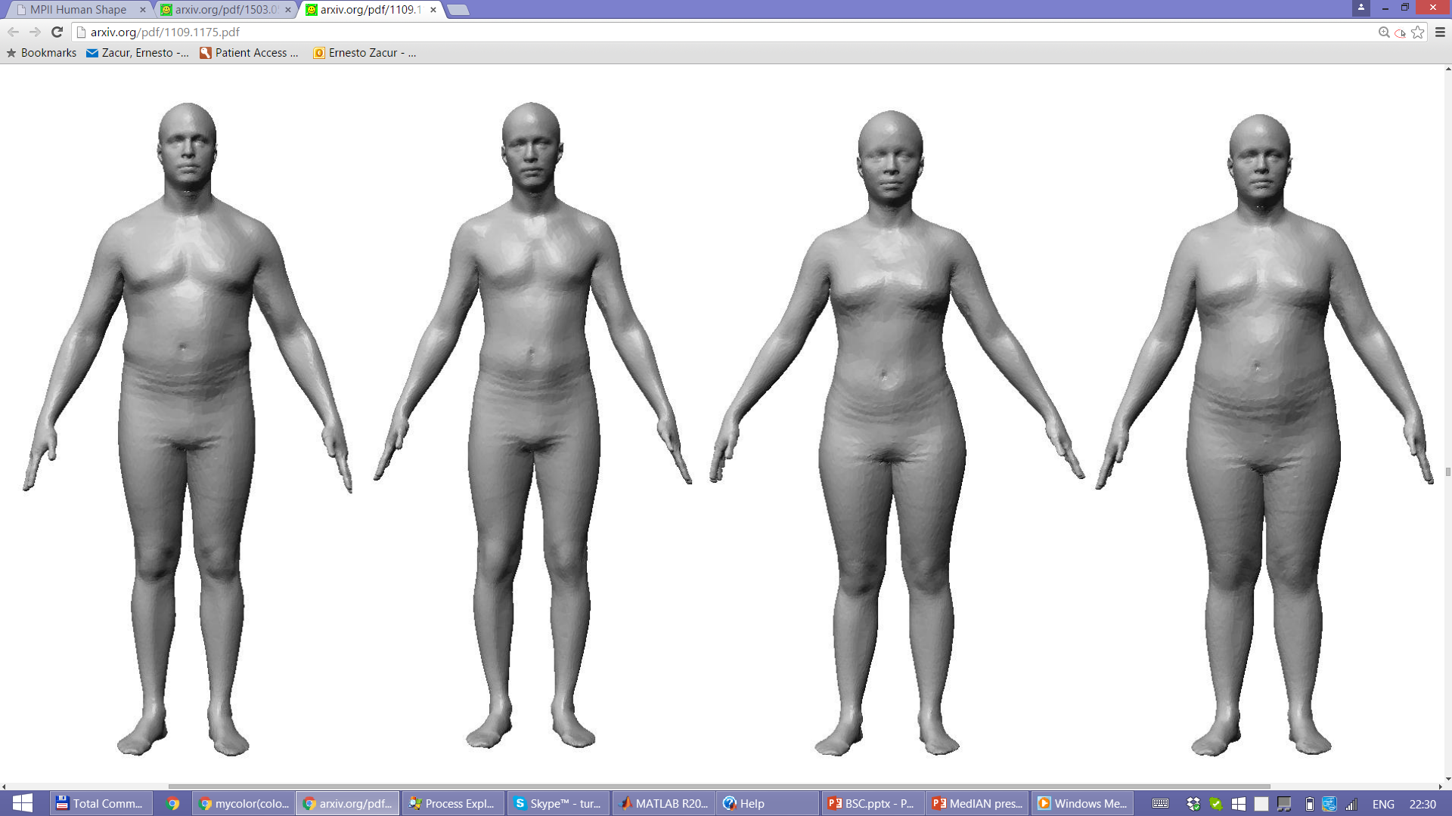
Most influential parameters
Temperature
Box size
Room temperature ~298 K
Simulation
??? K
Body temperature ~310 K
PV Coveney, S Wan, AP Bhati, AD Wade, "Which corners to cut? Guidelines on choosing optimal settings to maximise sampling with limited computational resources", ChemRxiv (2022) DOI:10.26434/chemrxiv-2022-2jdk2

Slide 18
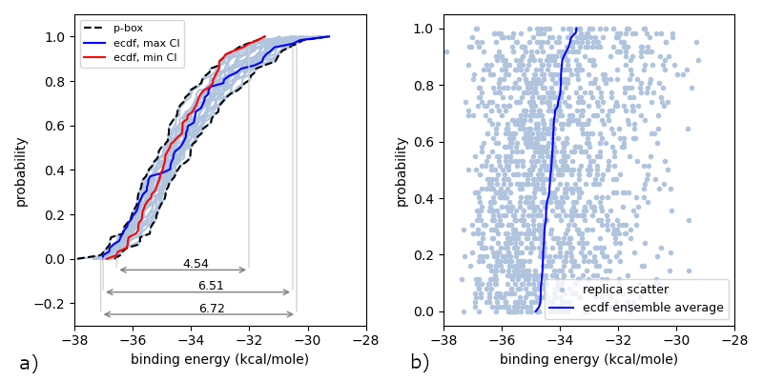
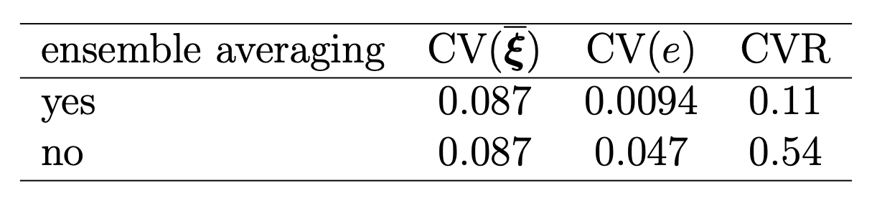
Significance of aleatoric uncertainty
analysis of p-boxes
output coefficient of variation (CV) depends on number of replicas
aleatoric uncertainty is non-negligible and dominates parametric uncertainty
ensemble averaging essential
molecular dynamics systematically damps input uncertainty (with and without ensemble averaging)
Vassaux, Wan, Edeling & Coveney, J. Chem. Theory Comp. (2021) 17 (8), 5187–5197

Slide 19
Distributions of free energies: Predictions from simulation
S. Wan, A. Bhati, A. Wade, P. V. Coveney, "Ensemble-Based Approaches Ensure Reliability and Reproducibility”, J. Chem. Inf. Model., DOI: 10.1021/acs.jcim.3c01654 (2023)

Slide 20
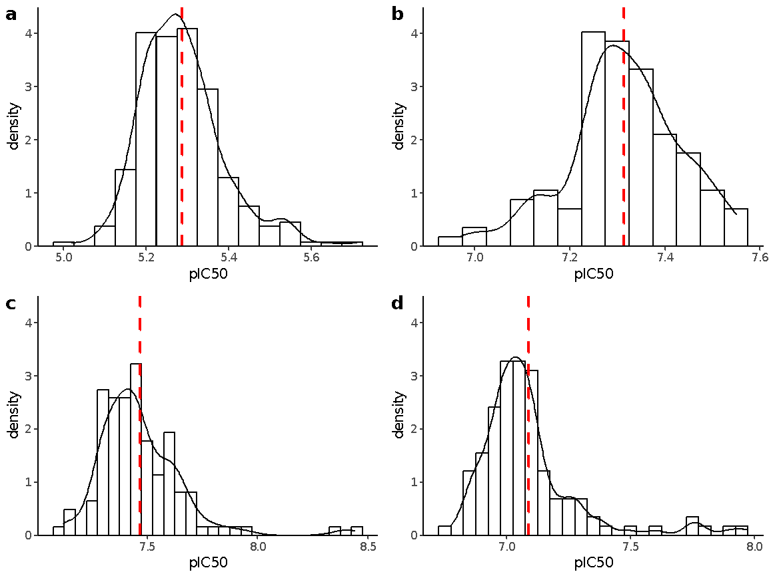
Distributions of free energies: Experimental measurements
Experimental binding affinity measurements from GSK
Compounds tested >100 times for their activities to SMYD3.
Compounds a and b do not show any drift in the assay over time, compounds c and d show a small amount of time dependency.
All distributions are skewed from a normal distribution
The excess kurtosis is positive, meaning that compared to a normal distribution, the tails are longer and heavier.
S. Wan et al., J. Chem. Inf. Model., 62, 2561-2570 (2022)
Notes:
These are experimental results collected by GSK for binding free energies. 4 compounds are tested here with over 100 repeated. The important result is that the distributions of results are non-gaussian. The nature of free energy distributions is the subject of our ongoing computational work, but for approx 50 computational replicas we can observe similar non gaussian distributions computationally which highlights the need for ensemble calculations and pattern 3 like compute.

Slide 21
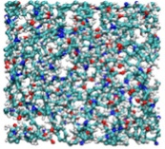
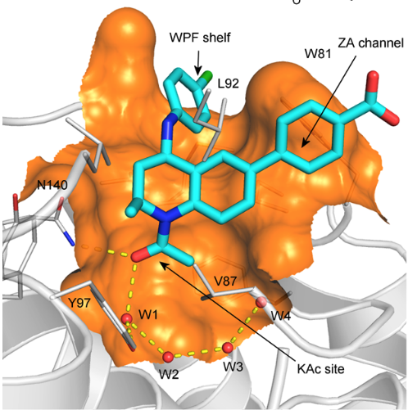
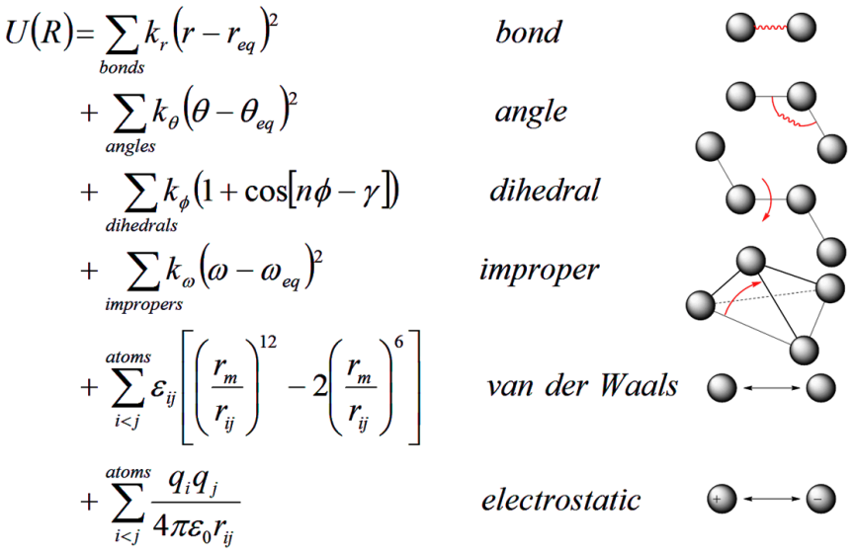
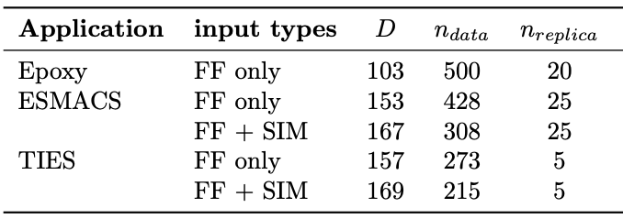
UQ contribution from the interaction potential parameters
Force fields used for molecular dynamics simulations

Slide 22
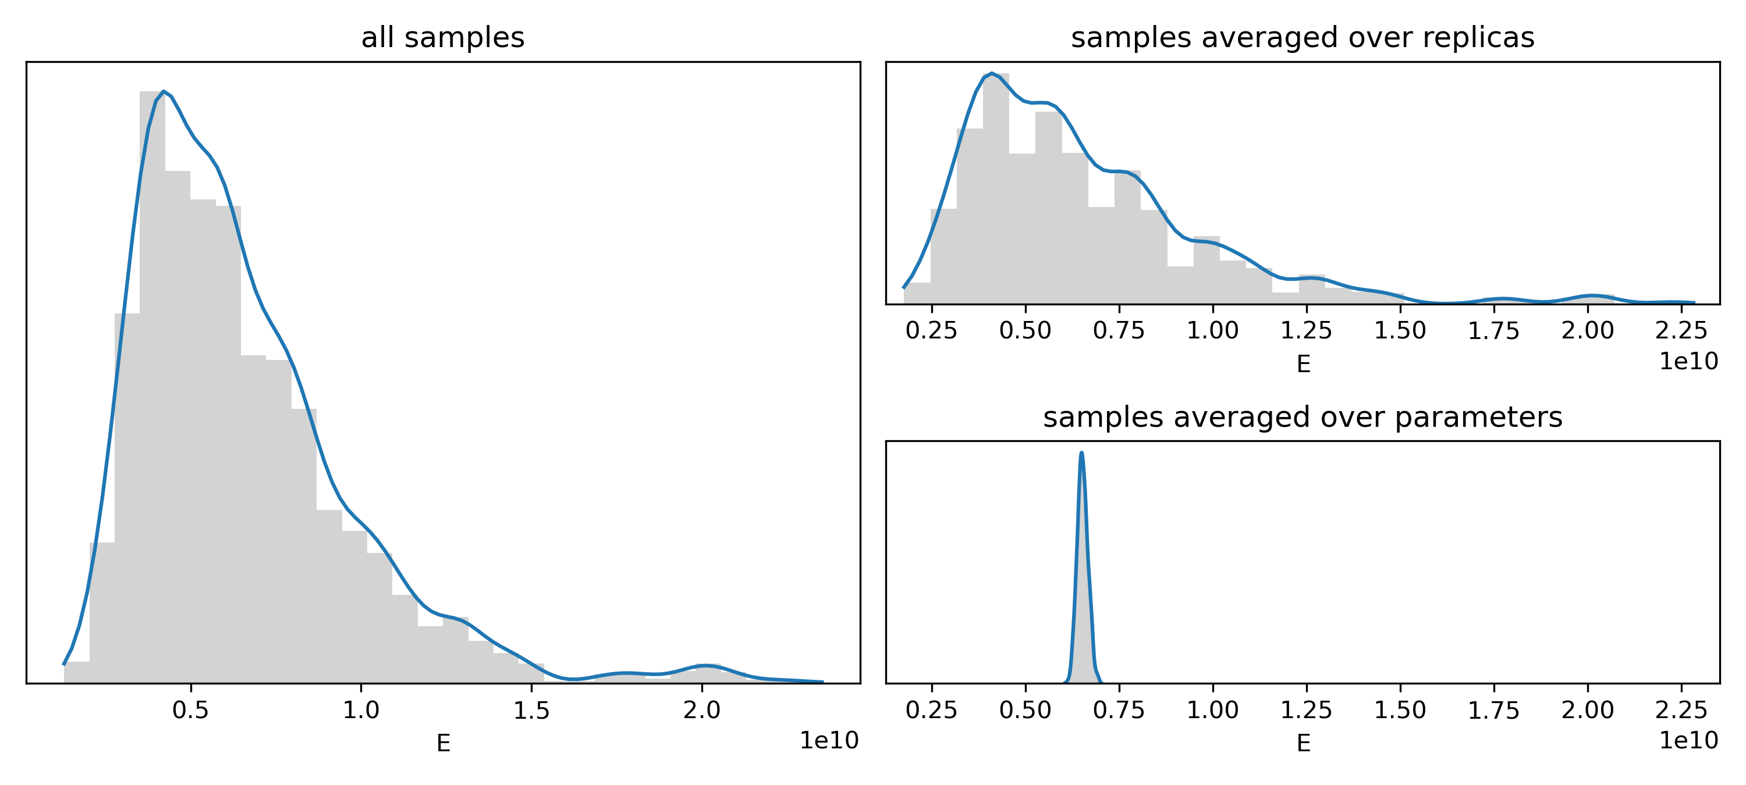
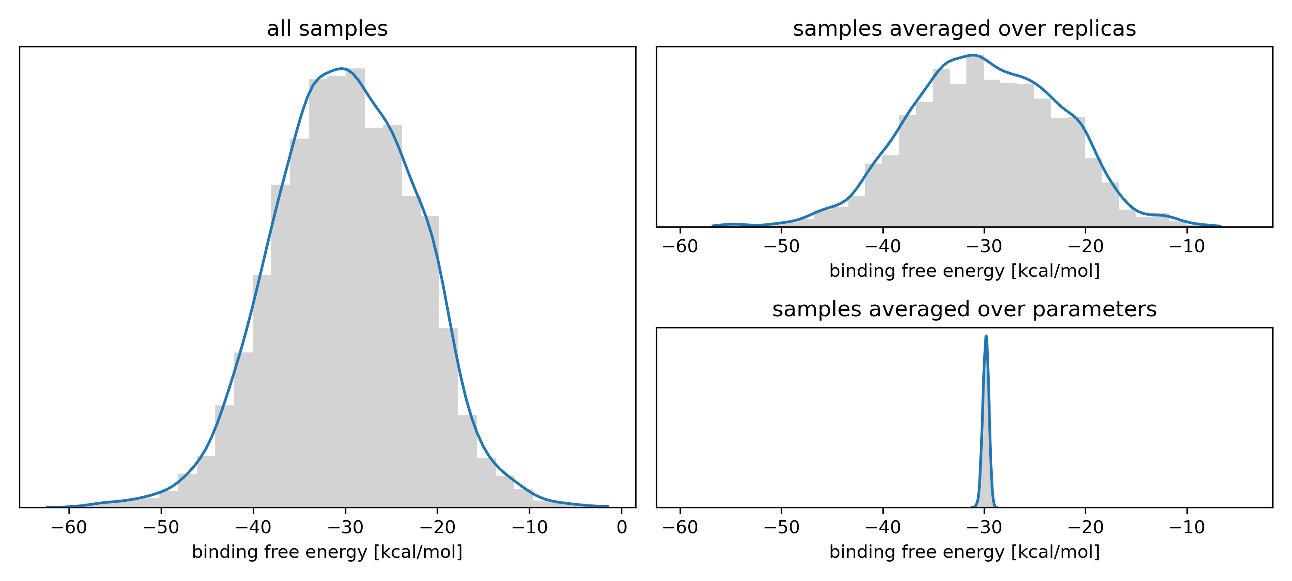
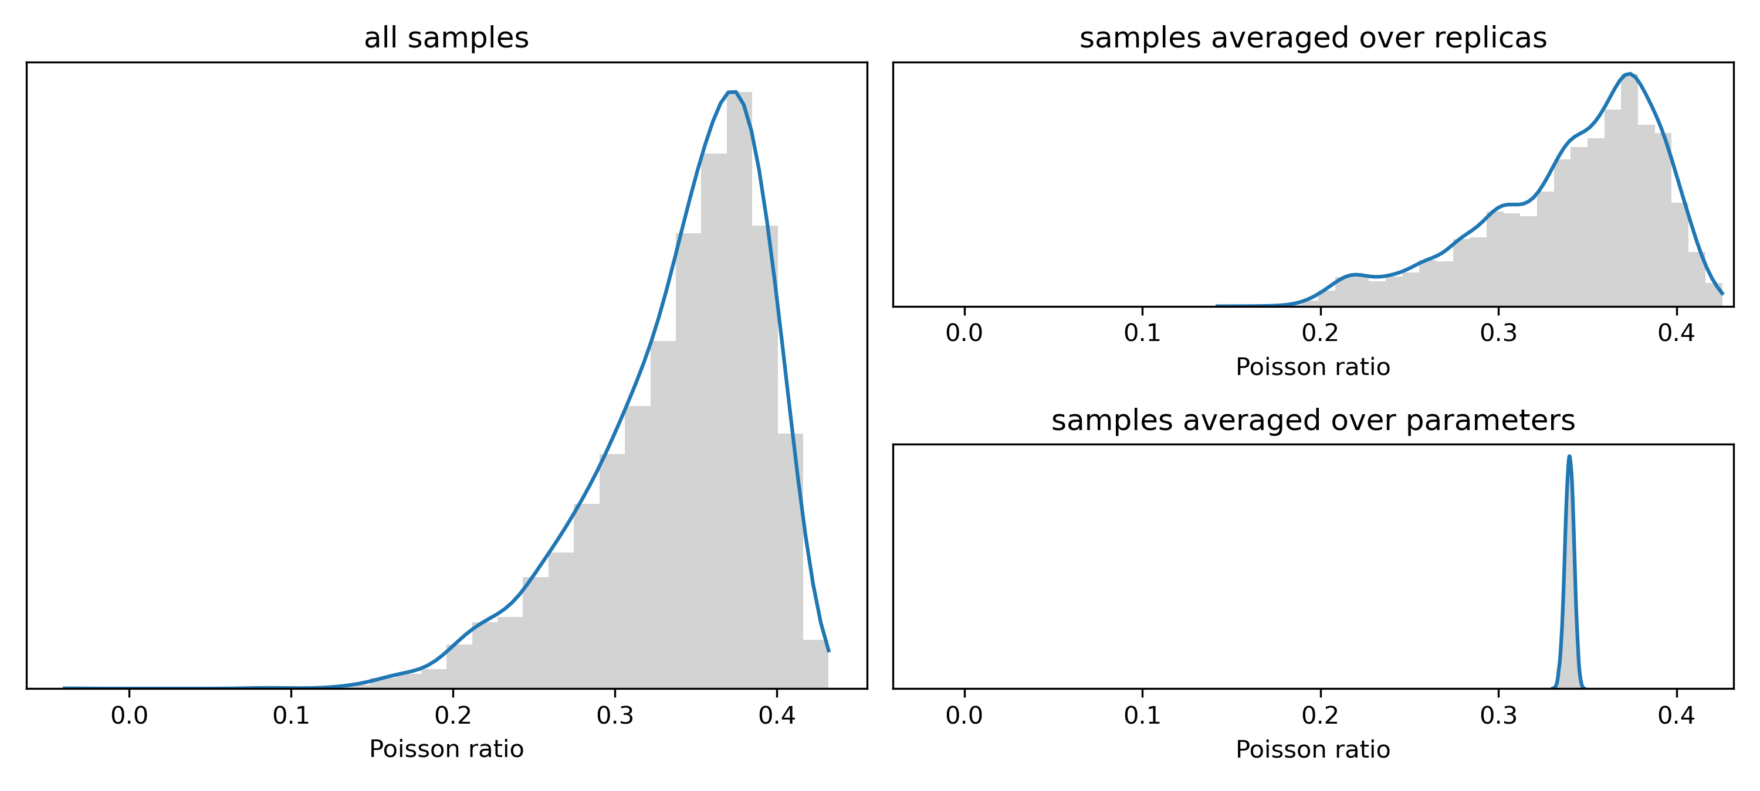
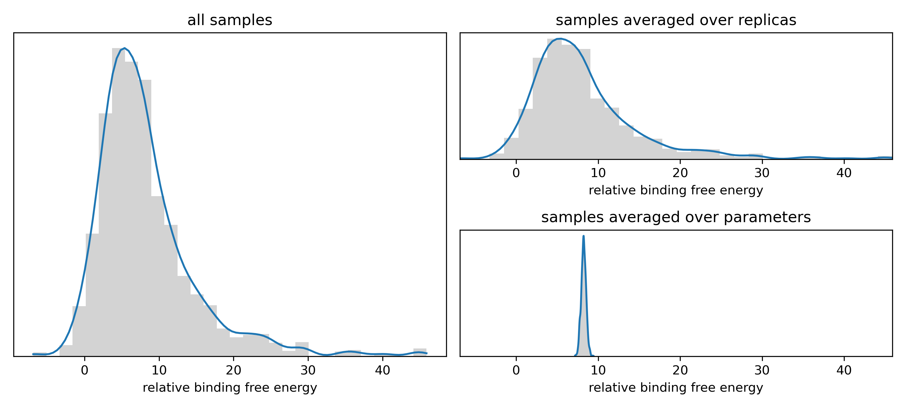
Epistemic vs aleatoric uncertainty
Epoxy resin, E output
ESMACS binding free energy
Epoxy resin, Poisson ratio output
TIES relative binding free energy
W. Edeling, M. Vassaux, Y. Yang, S. Wan, S. Guillas, P.V. Coveney npj Comput. Mater. 10, 87 (2024)

Slide 23
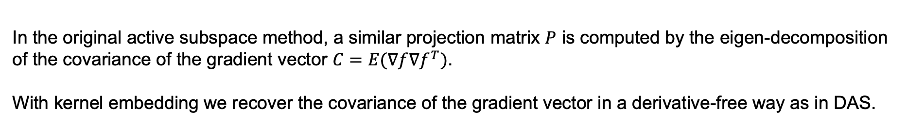
Deep Active Subspace & gradient Kernel Dimension Reduction
In our molecular dynamics study, we apply both DAS and gKDR to handle:
Dimension Reduction : Reduces the parameter space from dimensions N > 100 to 1
Sensitivity Analysis: the popular derivative-based sensitivity index can be estimated by projecting the eigenvalues back to each input parameter
Surrogate Modelling used in gKDR with Gaussian Processes to infer the uncertainty; in DAS we use a feedforward neural network
In the original active subspace method, a similar projection matrix $P$ is computed by the eigen-decomposition of the covariance of the gradient vector $C=E(∇f∇f^{T})$.
With kernel embedding we recover the covariance of the gradient vector in a derivative-free way as in DAS.

Slide 24
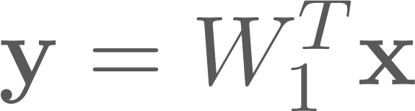
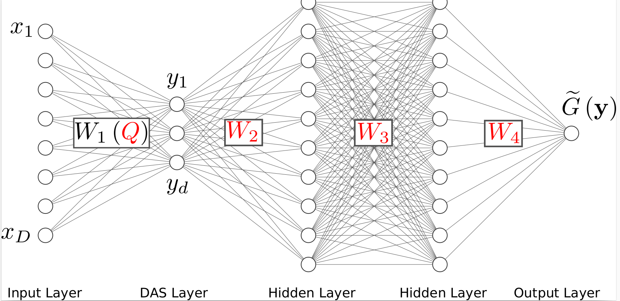
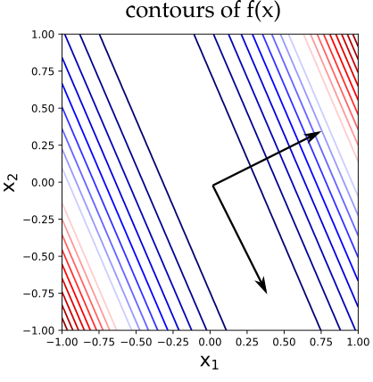
High-dimensional parameter spaces: Active subspace method
Goal: Find rotated coordinate axes in high-dimensional input space x that:
are low-dimensional
point in direction of largest on-average variability of f(x)
We can view as an orthonormal linear encoder, attached to input
Constantine, P. G., Dow, E., & Wang, Q. (2014). SIAM Journal on Scientific Computing

Slide 25
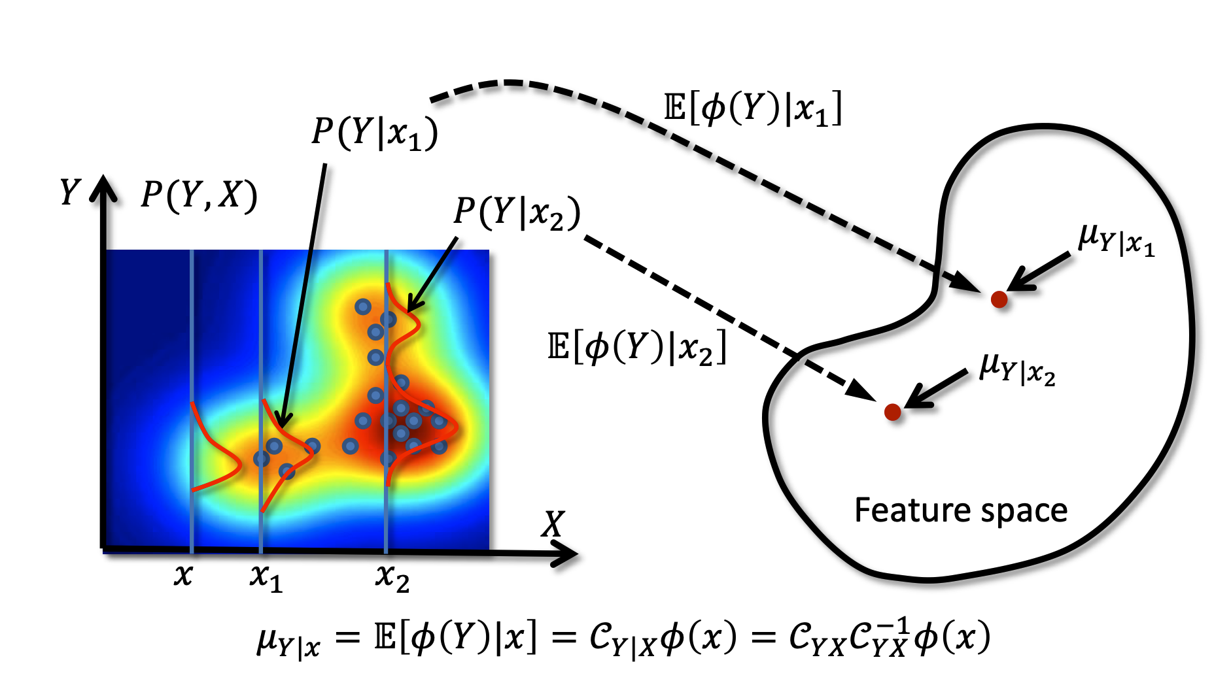
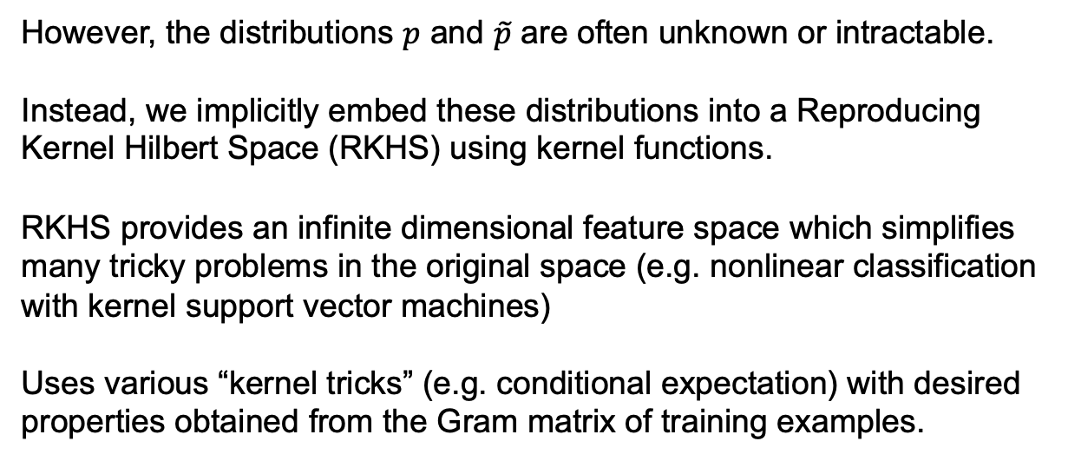
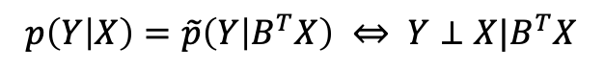
High-dimensional parameter spaces: gradient Kernel Dimension Reduction method
Target: We look for an orthogonal projection $B∈R^{m×d}, d≪m$ such that
$p\left(Y | X\right)=\tilde{p}\left(Y | B^{T}X\right) ⇔ Y⊥X|B^{T}X$
However, the distributions $p$ and $\tilde{p}$ are often unknown or intractable.
Instead, we implicitly embed these distributions into a Reproducing Kernel Hilbert Space (RKHS) using kernel functions.
RKHS provides an infinite dimensional feature space which simplifies many tricky problems in the original space (e.g. nonlinear classification with kernel support vector machines)
Uses various “kernel tricks” (e.g. conditional expectation) with desired properties obtained from the Gram matrix of training examples.
Kernel embedding of a conditional distribution (Le Song et al. 2013)
Song L, Fukumizu K, Gretton A. Kernel embeddings of conditional distributions: A unified kernel framework for nonparametric inference in graphical models[J]. IEEE Signal Processing Magazine 30: 98-111 (2013).

Slide 26
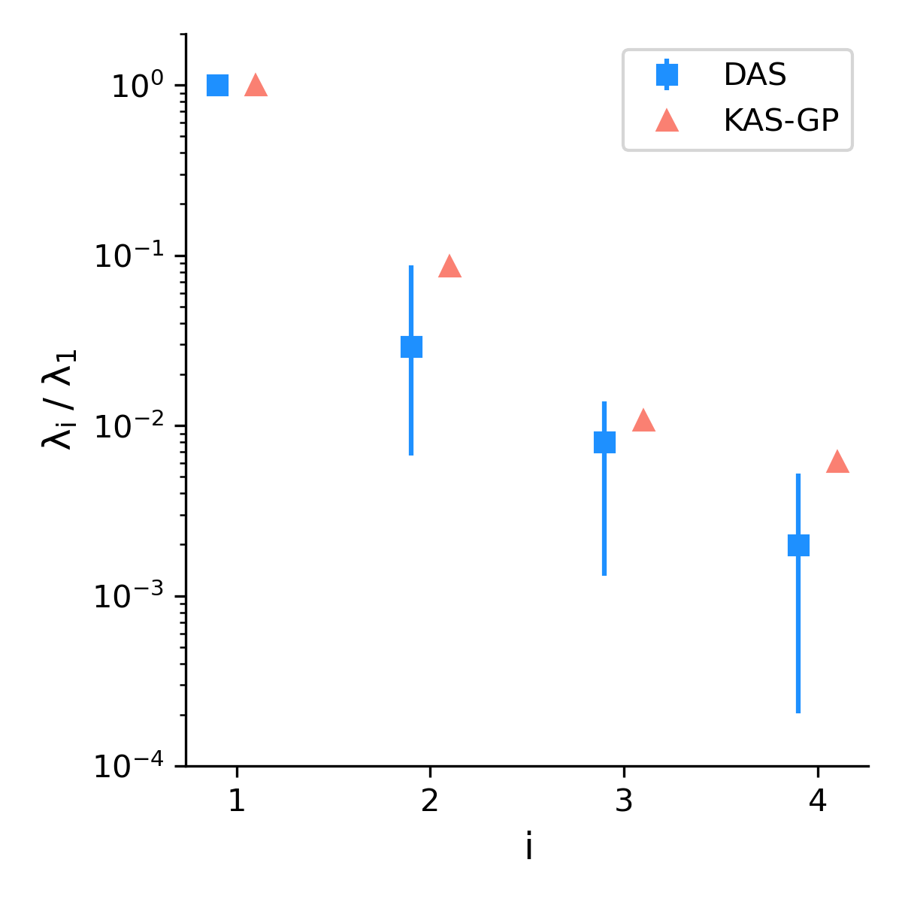
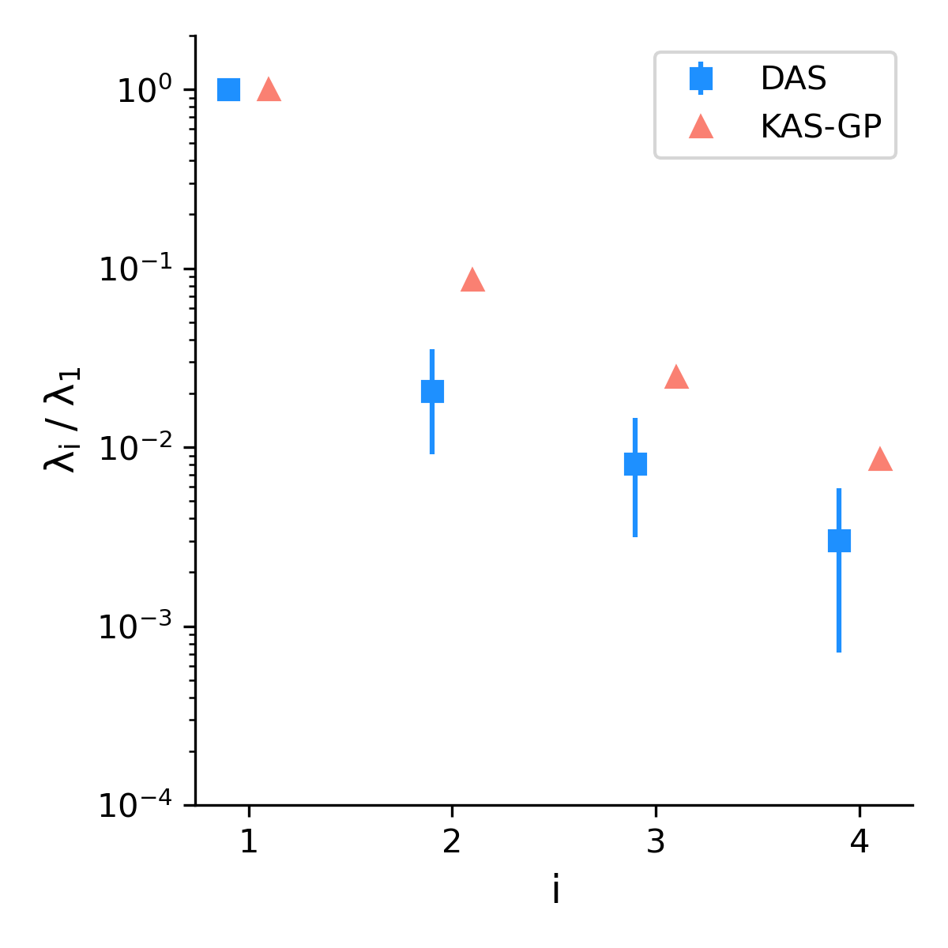
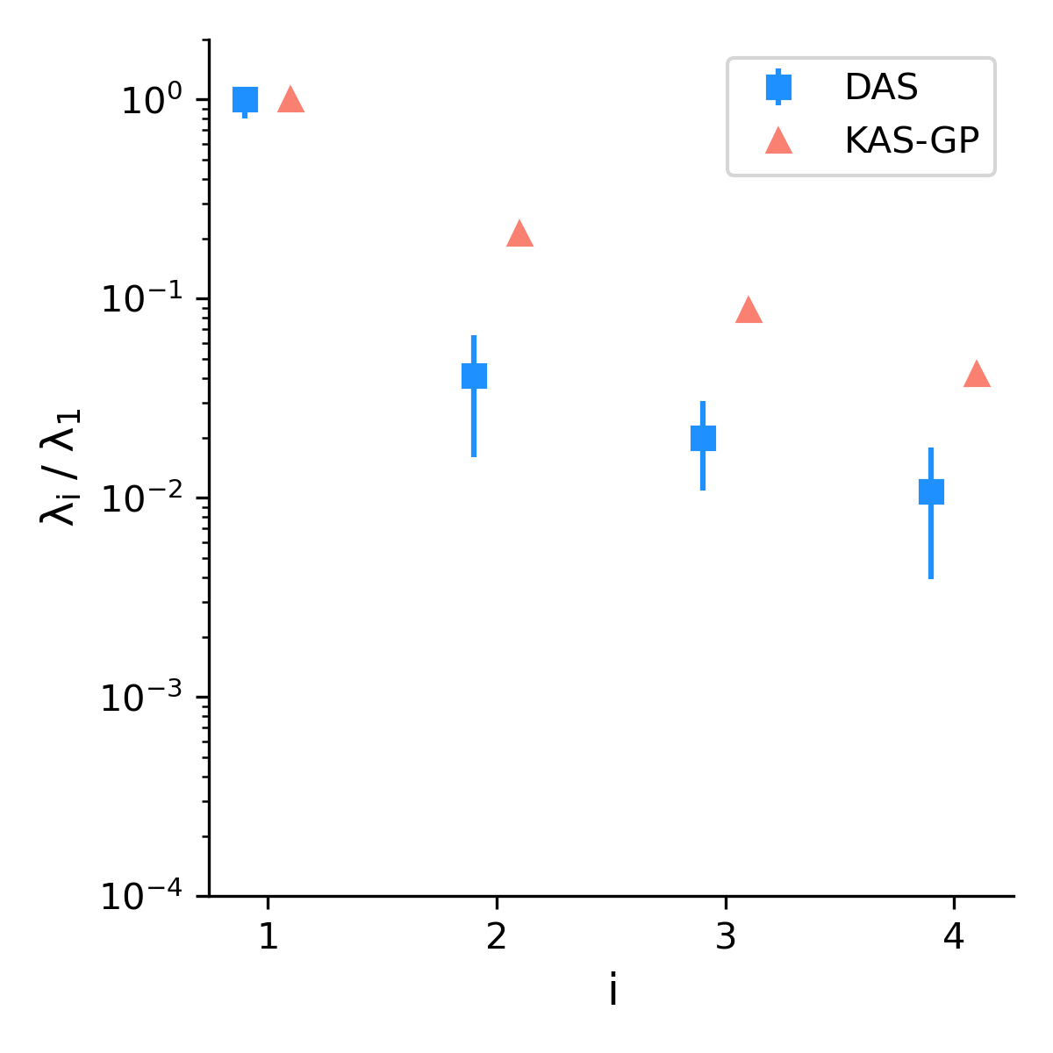
Dimension reduction
From the largest 4 eigenvalues of the gradient vector λ1 ≥ λ2 ≥ λ3 ≥ λ4 of both DAS and KAS-GP, we observe an eigengap |λ1 −λ2| of one order of magnitude, which is evidence of the existence of a 1D active subspace.
(a) Epoxy application, E output. The Poisson ratio produces a similar plot.
(b) ESMACS free energy application.
(c) TIES free energy application.

Slide 27




Active subspace approximation
The original MD models, a function of a >100-dimensional input space, are well approximated by 1D surrogates.
E surrogate
ESMACS binding free energy surrogate
Poisson ratio surrogate
TIES relative binding free energy surrogate

Slide 28




Global first-order sensitivity analysis
To identify the most sensitive parameters upon which the QoIs depend
E
Poisson ratio
Binding free energy
Relative binding free energy

Slide 29

Physical insight from sensitivity analysis
Allows us to identify the sources of the dominant contributions and the atoms to which the most sensitive parameters are assigned.
Top 5 most sensitive parameters
Orange
Yellow
Green
Yellow
Purple

Slide 30



Drug Development
Protein structure prediction
AlphaFold2: A ca. 10⁸ million-parameter model
the parameters lack any clearcut basis in relation to the underling physicochemical properties of these systems
one has no means of using insight/heuristics to reduce the number of parameters to make such a UQ study tractable.
J. Jumper, et al., (2021), Highly accurate protein structure prediction with AlphaFold, Nature, 596, 583-589.
Notes:
AI has a role to play in Virtual You. This grand challenge of finding a way to turn one kind of data—the amino acid sequence of a protein—into another—a threedimensional protein shape, which is crucial for understanding its role in a cell or body was completed by the AlphaFold AI in 2020. But we should not get carried away. These are static crystal structures, not the dynamic ones in our cells. There is still all the work yet to be done to unlock the science—the essential biology, chemistry and physics—of how and why proteins fold

Slide 31


Building Trust and Transparency into ML Models
Without a UQ analysis, one cannot know about the (un)reliability of predictions in real world applications.
“I agree with you that there is no point in discussing the implementation of flawed ML potentials for real-world MD simulations. The uncontrolled uncertainties and the transferability problem, along with limited training datasets to build the models, are all serious issues for its implementation.”
[294,565]
S. Succi, P.V. Coveney, Big data: the end of the scientific method? Phil. Trans. R. Soc. A. 377, 20180145 (2019)
https://openaccess.thecvf.com/content/ICCV2021/papers/Wang_Energy-Based_Open-World_Uncertainty_Modeling_for_Confidence_Calibration_ICCV_2021_paper.pdf
P. V. Coveney, E. R. Dougherty and R. R. Highfield,
"Big Data Need Big Theory Too”,
Phil Trans R Soc London A, 374, 20160153 (2016)

Slide 32

Oxford University Press
2025, forthcoming
http://gsp.tamu.edu

